Slide 1

SolidarioGB
Operation Red Trench
A Strategic Blueprint for Transitioning the British Working Class Movement from Cadre Party to Mass Party

Slide 2

Operation Red Trench
The Crisis & The Solution
Executive Summary
Labour has shifted right, new left parties have collapsed, and the far right is recruiting from the working class. Britain faces a structural vacuum on the left.
The Problem
The Solution

Slide 3

Operation Red Trench
Diagnosis: Why Current Projects Failed
Failed
60K
Works
Your Party UK collapsed from 600K signups to 55K members
Communist parties fragmented with no shared strategy
UVW & KPÖ Plus succeed through material solidarity

Slide 4




Operation Red Trench
01
02
@SolidarioGB
Five Pillars of Transition
Territorial Base Organisations
Class Composition Project
03
04
Political-Educational Infrastructure
Electoral & Unity Strategy

Slide 5
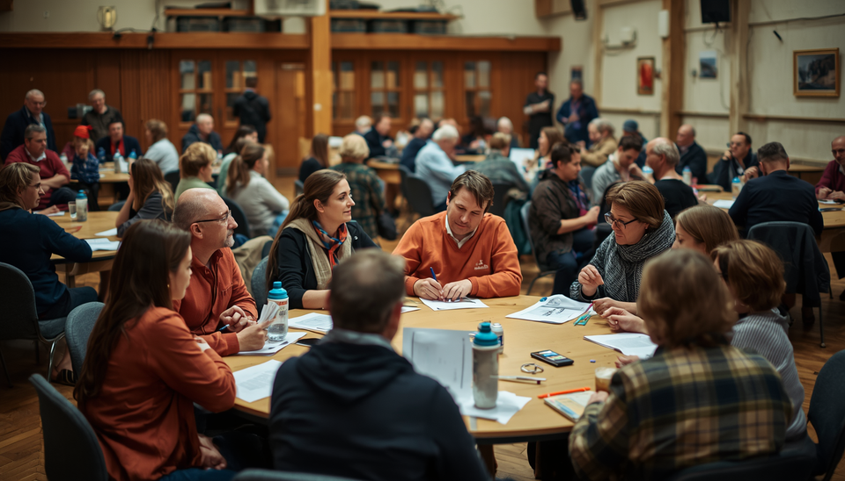
Operation Red Trench
Five Pillars of Transition
Pillar 1: Territorial Base Organisations ("Red Trenches")
Local hubs offering casework and solidarity, workplace organising, and political education in working-class communities.
30 Red Trenches
5,000 Active Members

Slide 6



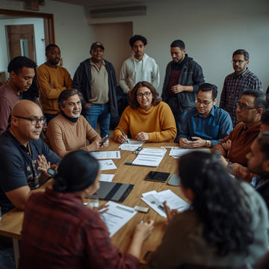
SolidarioGB
Gig Economy
Essential
@operationredtrench
Class Composition
Project
Platform Workers
Care & Health Workers
Supply Chain
Solidarity
Logistics & Retail Sectors
Migrant Worker Organising Priority

Slide 7



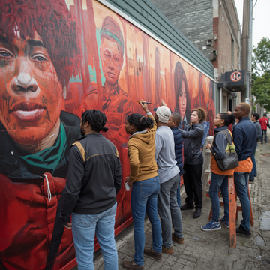
Pillar 3
01
02
@SolidarioGB
Political-Educational Infrastructure
Red School
Red Press
03
04
Red Library
Red Culture Collective

Slide 8

Operation Red Trench
Pillar 4
Electoral Strategy: Delayed & Conditional
Focus on local elections only after building genuine community presence. All candidates live on worker wages and remain accountable.
No parliamentary candidates before 2031
Recallable representatives

Slide 9

Operation Red Trench
Unity Strategy
RCC
RPC
CWM
Practical unity leading to potential future fusion
Red Platform shared minimum programme
Coordination without merger or dissolution

Slide 10
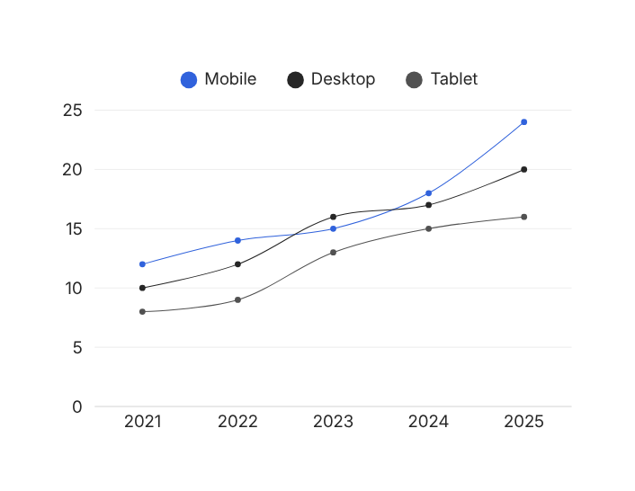
Operation Red Trench
Implementation Timeline
5 → 15 → 30
5,000
Red Trenches established nationwide
Active members by Phase 3
3-5 Seats
250 → 1,500
Council seats targeted by Month 36
Growth trajectory over 36 months

Slide 11




SolidarioGB
01
02
@solidariogb
Organisational
Principles
Democratic Centralism
Living Wage Principle
03
04
Transparency & Accountability
Internationalism & Anti-Imperialism

Slide 12
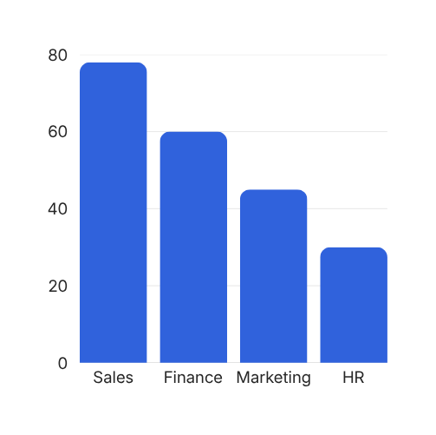
Operation Red Trench
Risk Analysis
4
3
High Probability Risks Identified
Critical Mitigations Deployed

Slide 13

SolidarioGB
Join the Red Trench Movement
"The party is not a doctrine to be perfected but a practice to be built."

